Slide 1
Random Forest

Slide 2
RANDOM Forest
Kind of like KNN
“Weak learners” (singles) come together to form the “Strong learner”

Slide 3
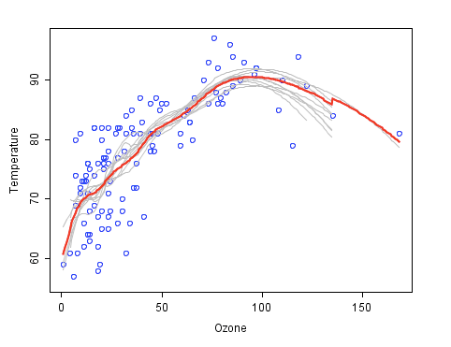
RANDOM Forest
Blue Circles ➔ Data
Gray Curves ➔ Weak Learners
Red Curve ➔Strong Learner

Slide 4
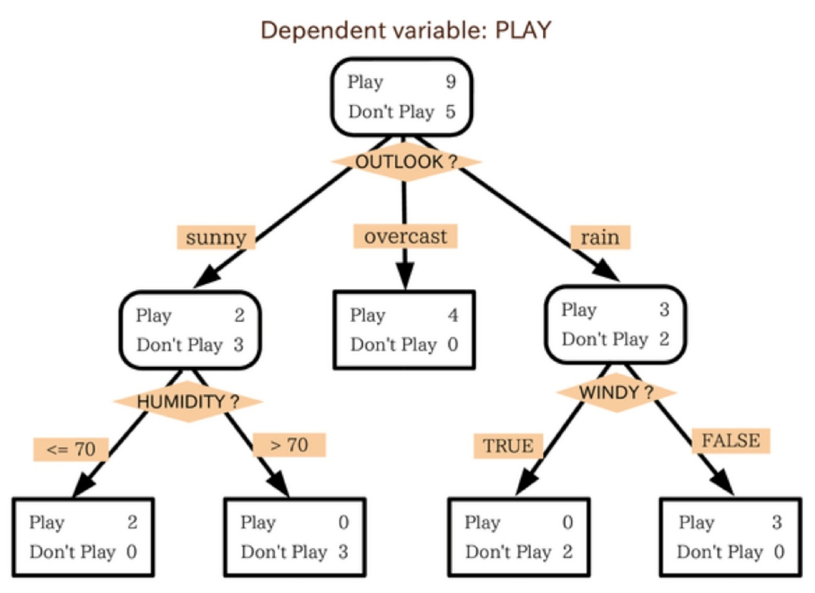
RANDOM Forest
Algorithm: Decision Tree (@ClassicML)

Slide 5
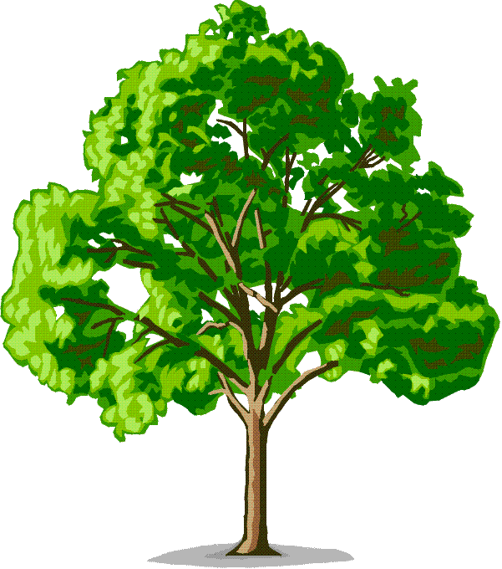
RANDOM Forest
Random FOREST combines the TREES into a FOREST
  Tree ➔ Weak Learner
  Random Forest ➔ Strong Learner

Slide 6
RANDOM Forest: Training
Sample N cases at random with replacement to create a subset of the data.
At each node:
  m predictor variables are selected at random from all the predictor variables
  Predictor variable with the best split makes a binary split on that node
  Next Node: Repeat

Slide 7
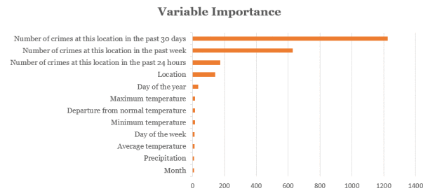
Example: San Francisco Police Department
Data: crime reports
Predictor Variables:

Slide 8
RANDOM Forest: Strength/Weaknesses
STRENGTHS
Fast runtimes
Deal with unbalanced and missing data
WEAKNESSES
May over-fit noisy data

